Slide 1
M3Clinician iPad App
Instructions for:
Downloading
Updating
Redirecting

Slide 2
Overview
M3 Information provides an IOS through iTunes for patients taking the M3Clinician Behavioral Screening tool using an iPad
This document provides instructions to download, update, and ensure the iPad app is “pointed” to the correct environment.
Questions may be sent via email to support@m3information.com or by calling our office at 301.444.4400 and asking for Support.

Slide 3
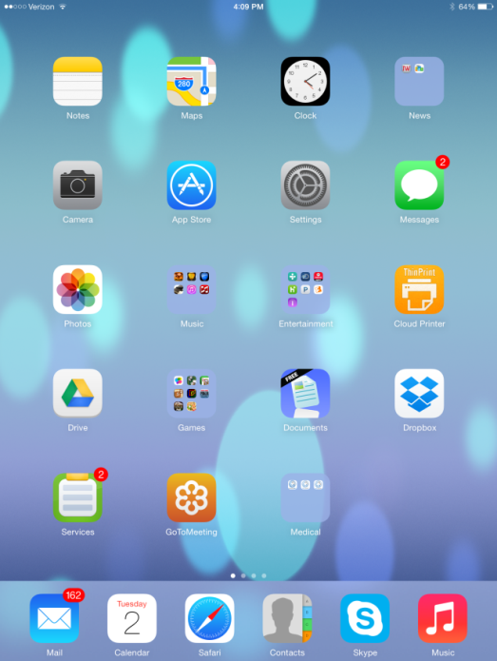
Downloading the App
To download the M3Clinician app, launch the App Store on the device you wish to use for patient screening.

Slide 4
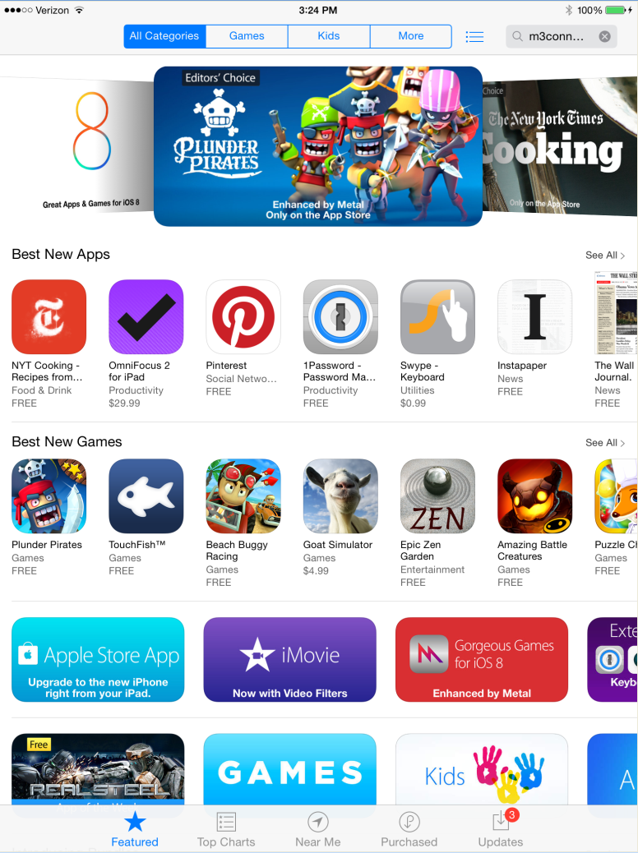
Downloading the App
Search for “M3Clinician” in the search bar.

Slide 5
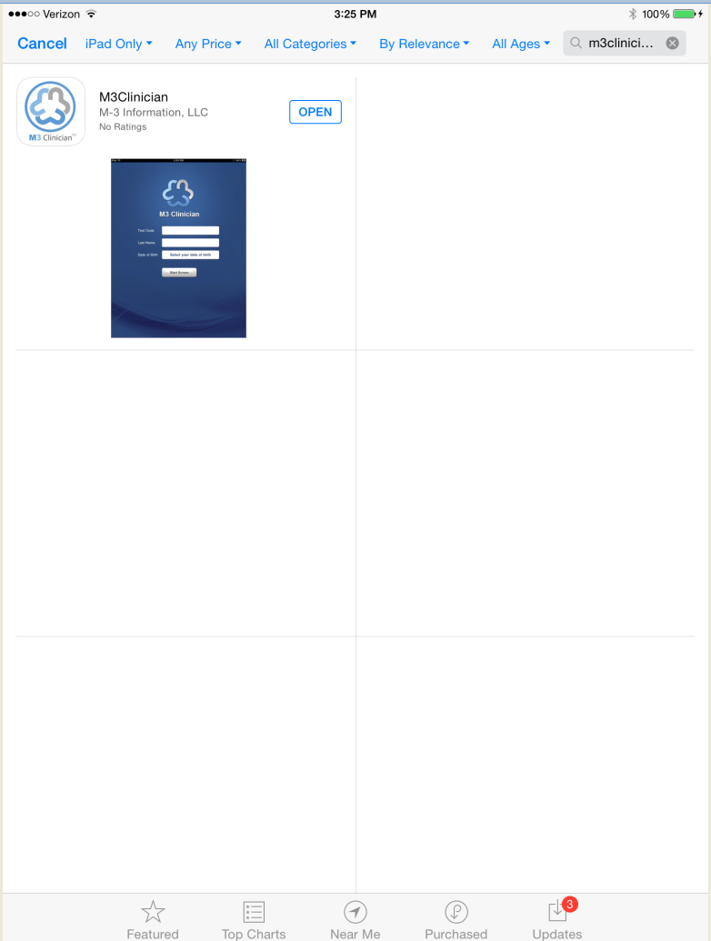
Downloading the App
Click the “Free” button to start the download.
Free

Slide 6
Updating the App
From time to time, the iPad app must be updated. This will come from M3 Clinician Site Administrator being notified or through a message when the app is launched.
When you receive an update notice, remember to update every device used for M3Clinician assessment screens.

Slide 7
Updating the App
To update the M3Clinician app, launch App Store on the iPad used for patient screening.

Slide 8
Updating the App
Click “Purchased” on the tool bar at the bottom of the page.

Slide 9
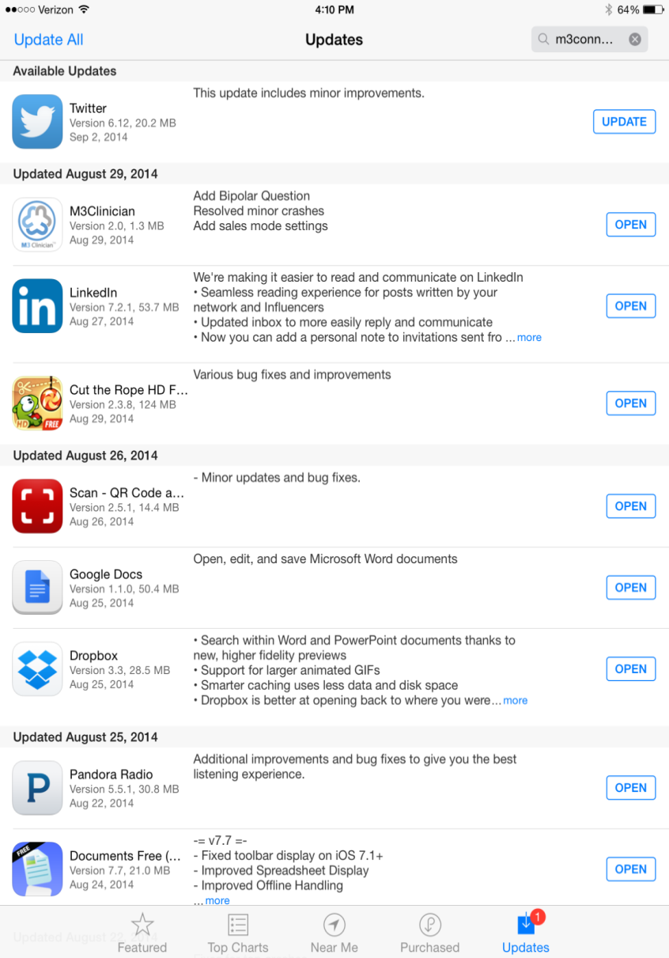
Scroll through the apps until you see M3Clinician and click on the “UPDATE” button. This will download the latest version of the M3Clinician app.

Slide 10
“Pointing” the App
The same M3 Clinician iPad app can be used for testing as well as your normal clinical work.
Most users will never use this feature unless contacted by the technical support team.
This section describes how to ensure the iPad app is “pointed” to the proper database (test or production).
This must be done on every device used for patient screens.
This process should only be performed at the direction of the M3 Support Desk.

Slide 11
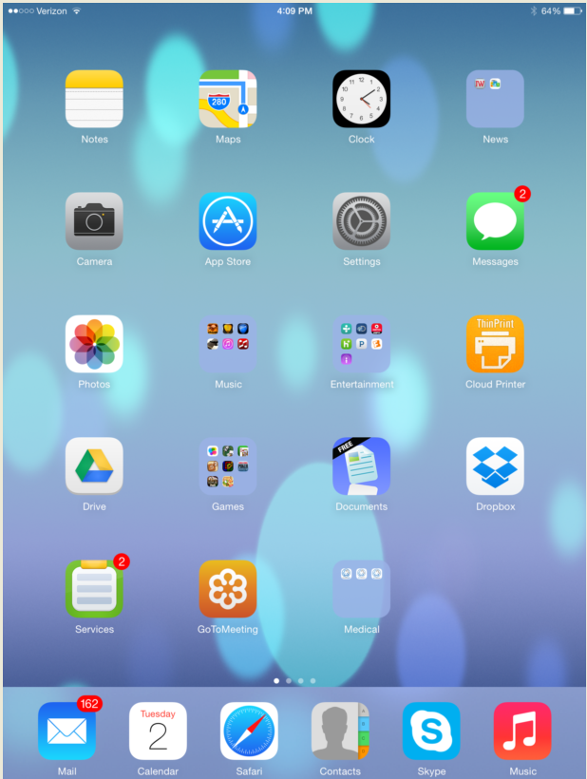
“Pointing” the iPad App
Start by clicking on the “Settings” app on the iPad.

Slide 12
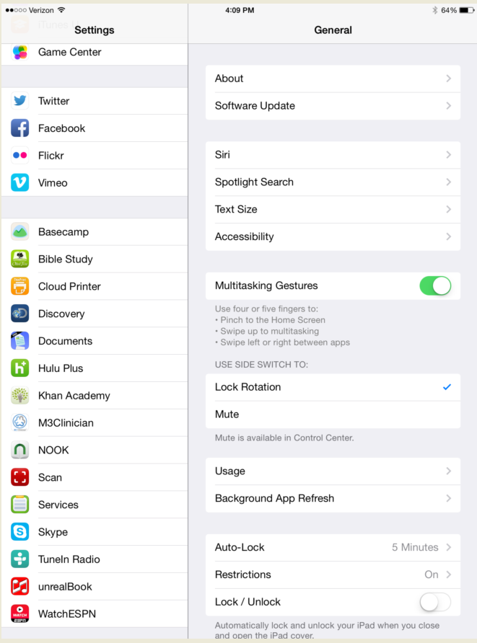
“Pointing” the iPad App
Scroll through the apps and click on the M3Clinician app.

Slide 13
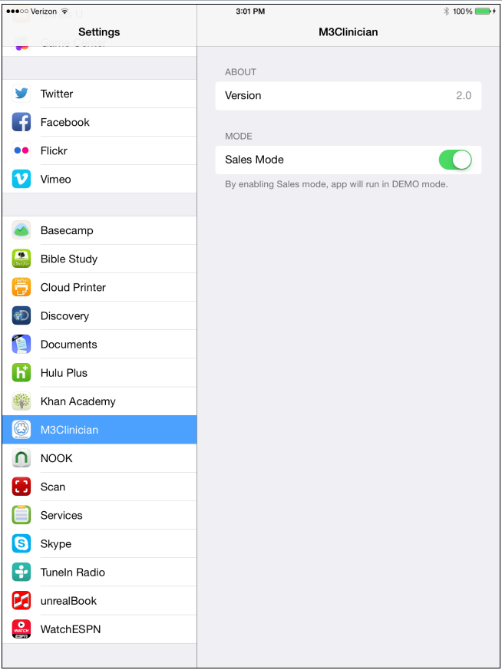
“Pointing” the iPad App
When the iPad app is downloaded or updated, it should be in the default mode “Production” mode. By sliding the switch to the right as shown, the app can be pointed to the Demo or Test environment.
IMPORTANT NOTE:
This process should only be performed at the direction of the M3 Support Desk.

